Slide 1


DATA SCIENCE - Analytic task
Based on FIFA World Cup 2026

Slide 2
Analytic question formulation
What is the average age of rostered players who scored at least one goal during the FIFA World Cup 2026? Exclude players who did not score?
Data wrangling | Data preparation and sampling | Descriptive statistics | Inferential statistics (Confidence interval) | Inferential statistics (either a One-Sample t-Test OR a Two-sample t-Test)

Slide 3
Results
Average age of rostered players who scored at least one goal?
Sample and populations
Sample size | Population | Mean | Mode | Range | Sample Standard Deviation | 95% Confidence Interval for Mean Age:
n= 50 N= 81 |  | Mean- 28.20 years Mode- 29.0 years |  | (Max: 41.0 - Min: 18.0) | 5.54 | (26.63, 29.77) years old

Slide 4
Do older veteran players get more goals?
Two-Sample T-Test & Sub-Group Analytics (Scorers Only)

Slide 5
Younger players vs Older players
Did younger players score more goals than older players?
Younger Scorers (Age <= 28.2 yrs): n = 25
Mean Goals: 2.16
Standard Deviation: 2.12
Standard error of Mean (SEM) : 0.42
95% Confidence Interval for Goals: (1.29, 3.03)

Slide 6
Older players vs younger players
Older Scorers (Age > 28.2 yrs): n = 25
Mean Goals: 2.28
Standard Deviation: 1.79
Standard error of Mean (SEM): 0.36
95% Confidence Interval for Goals: (1.54, 3.02)

Slide 7
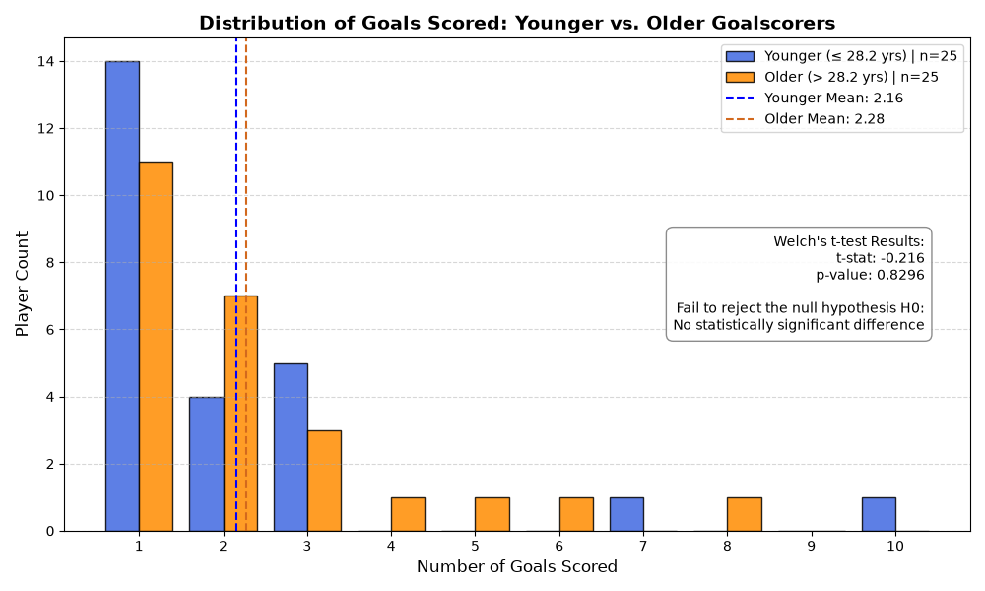
Distribution of goal scorer young vs old.
Histogram

Slide 8
(Two-Sample t-Test)
T-Statistic: -0.2165
P-Value: 0.8296
Conclusion: Fail to reject the null hypothesis H0: No statistically significant difference

Slide 9
Conclusion
Using different statistical method helped me learn

